Slide 1
Score Study in the Choral Classroom.
Mike Bossman
mike.bossman@k12.sd.us
Notes:
Welcome Nerds! I love score study and knowing the music inside and out - hopefully after today you will too! I am using Google’s question and answer tool so if you have a question throughout go ahead and add it at the link on the top and I will answer as we go. Even if you don’t have a question throw one up there so I know it works.

Slide 4
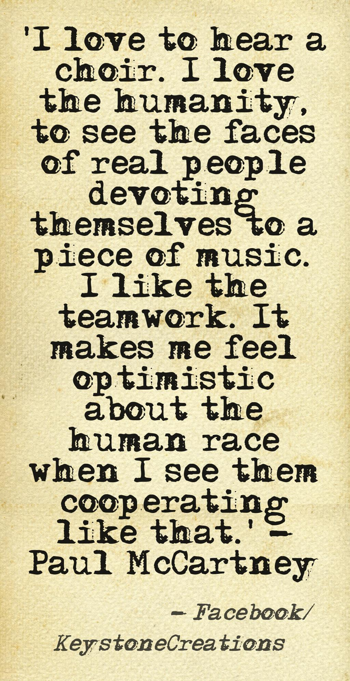
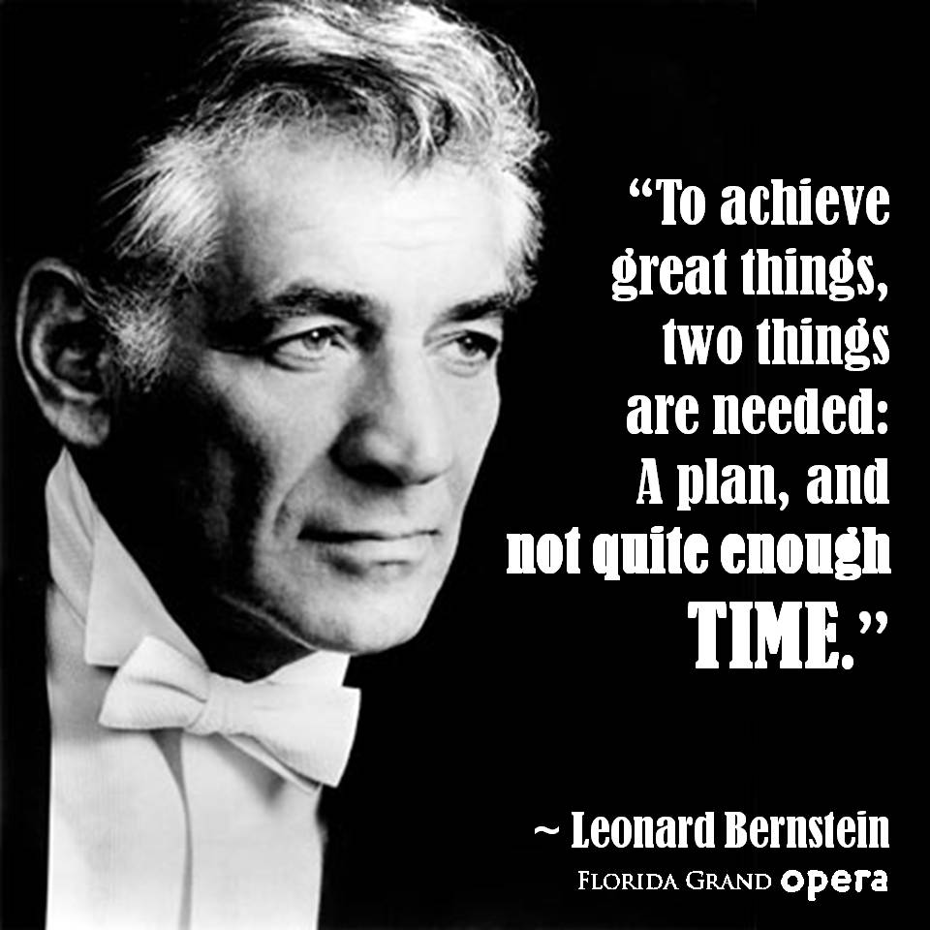
Notes:
There is something amazing about singing that you are all familiar with but here are some quotes to help cement that idea. Especially from Bernstein who talked about a plan! Any top of the line conductor will come into a rehearsal with the score being part of them and only needing it for reference. When I was at USD we did Verdi’s Requiem - the conductor came to work with the choir and didn’t look at her score once!

Slide 5
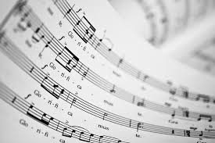
WHAT is score study?
Break that down into two parts - the score, and then studying.
Notes:
Dave D-K at USF once told me, and I don’t know if he remembers saying this to me but he said, “ know your scores” - I remember lots of times when he was at RHS never looking at his music or not evening having it out with him to conduct from.

Slide 6
Select great music!
Notes:
Let’s see - where is that soap box I asked to have delivered here?! You have to pick good music, know your students, know your accompanist, find music that has great text and great texture, beautiful lines, pick music that moves you - and some fun music that still has content that you can sink your teeth into!

Slide 7
More importantly WHY do we need to do score study?
Erich Leinsdorf, in his excellent text, The Composer's Advocate, reminds us that the score is not the music. One might think of the score in the same way as an architect's drawing - the building does not exist on paper, but it is the primary source from which it will be created. Neither is it the only thing you will need to come up with the end product.
Taken from: http://www.timreynish.com/conducting/conducting-articles/score-study-part2.php
Notes:
I found this quote online and thought it was quite fitting!

Slide 8
More importantly WHY do we need to do score study?
Macro/Micro picture of the music.
It is our curriculum/Rehearsal plans.
You must be prepared and ready.
Convey the composer's intent or make sure music is performed properly.
Public performance.
Notes:
Important to remember what we do and why we do it. Again, many other reasons these are just a few.

Slide 9
HOW?
I use a color-coded system to help me quickly identify while in rehearsal.
Notes:
I have brought some colored pencils for you to use! I couldn’t get enough highlighters - but this work well because...

Slide 10
Goin’ Home
Based on Largo from Symphony No. 9
By Antonin Dvorak
Words and Music by Paul Langford
Notes:
Popplers has graciously donated the copies of the score today! Make sure to visit their booth tomorrow for more great stuff!

Slide 11
What kind of things am I looking for in the music?
Basics
Dynamics
Key Signature/Time Signature
Articulations
Tempo
Rests/Other
More In-Depth
Phrasing
Text
Voice Part Study/Melody and Harmony
Range
Form
Notes:
A lot of these depend on how much time you have - I’ll admit I typically spend a great deal of time working on this but I love it! For you might need to prioritize what you decide is most important.

Slide 13
First things First
-Number my measures!
-Research the composer/arranger
-Is the piece a stand alone or part of a set?
-What is the style?
-Play through the piece - part by part and then all together.
-Listen to a recording
-Translate the text (write in the translation/pronunciation)
-Speak the rhythm
-Sing through all the lines individually
-Identify spots that will need some extra work time.
Notes:
Not all score study is writing stuff in the music - lots of it is prep work on the front end, like research, playing through the parts, listening to recordings if you do that. Starting to put the bigger picture together. Thinking about what my rehearsal plan will look like - what are the steps we need to take as a choir to get this piece performance ready.

Slide 14
Dynamics -
I use a blue highlighter for all dynamics -
-I first go through and highlight all dynamics.
-I then go through and if the composer/arranger has written cresc. I will physically write in a crescendo or de.
-Then I look at the why - why did the composer put the dynamic in that spot?
-After I have finished with the score study I come back and review the markings - Do I agree with all of them?
-As the conductor I have some give and take on a few things - I might add or subtract or minimize a dynamic or keep them.

Slide 15
Key Signature/Time Signature
-I usually just write in the key signature at the top of the first page.
-I write it again if it changes in the piece.
-I use a purple highlighter to mark any accidentals in the vocal lines.
-Then I might check the chord structure in those places to see why the accidents were used - might be quick key change w/o writing it in or just fits with the text.
-Time Signature I highlight with a pink highlighter.
-If I need to write in the counting in a tricky spot I will use a pink pen to keep with the continuity of the pink color for time signature.
-This also helps with my conducting patterns especially if a song switches quickly.

Slide 16
Articulations -
-I use an orange highlighter for any articulations in a piece.
-That includes things like staccatos, breath mark, fermatas, tenutos, accents, anything of the like.
-These often get missed in the mix of things and it just serves as a reminder as I am teaching.
-I like to teach my students to look the whole score and not just note by note.
-How do these affect the music?
-Are there ones that my students will know or will I need to teach them
-How will I conduct the fermata? Will my students know to watch?
-How do I teach staccato singing vs. legato singing?

Slide 17
Tempo -
-I use a green highlighter for all things tempo related.
-This includes the opening line that describes the speed of the piece. I also highlight any rits or accels in the song.
-After listening I might identify a section that should slow down or need a change that maybe isn’t written in the music.
-Will I need to practice my conducting pattern at the end so the students understand how/when to slow down.
-If there is an accel in the music how do I make sure the students stay with me and all speed up at the same time to the same speed?
-Do I need to change my pattern and break it down into a different set to accommodate the speed change?

Slide 18
Rests/Other -
-Any rests in the music that are ones to watch for I circle in red.
-Your run of the mill rests I don’t mark but ones that I need a reminder one I put a big circle around so I don’t miss them.
-Any time I see a longer note I put an arrow behind it to remind me and the singers to hold the note for its full value.
-I mark with a yellow highlighter any other important note in the music.
-If a part moves from parts to unison, if there are expressive markings in the music, if there is an added instrument part.
-That is it for the basics - with these things accomplished you are set for a micro-vision of the piece.

Slide 19
In-Depth
More In-Depth
Phrasing
Text
Voice Part Study/Melody and Harmony
Range
Form
Historical
At this point you are looking for more specific things - these might take more time than the basic. Equally as important but probably not accomplished the ten minutes before rehearsal.
Notes:
These are the things I do if I have more time - but still so very important! We aren’t necessarily going to do this together but let’s look at the first line and discuss how you might articulate that.
What is the important word?
You basically repeat the same words over and over again - showing importance
Where do we breath? Do you ignore the breath or take it?
What scene do you describe - how does this part make you feel?
Let’s sing it!

Slide 20
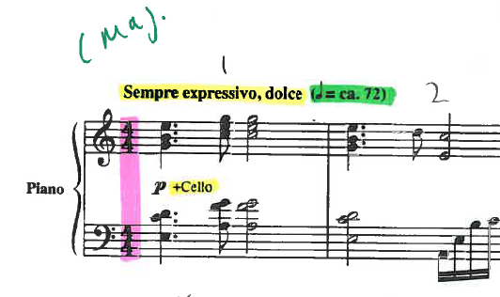

Slide 21
forScore App
Great app for having your music with you at all times but also great for score study!
Notes:
I love this app! I use it for lots of different applications but mainly for chorus. Now if you have a mini - not so good to conduct from but would still work great for score study purposes. This is a paid app but worth it - not only can you just take a picture of the score but you can also scan in the music. I use it for rehearsal and for study!

Slide 22
https://forscore.co/
Notes:
Here is the web address for more info - or just google it.

Slide 24
Take Aways
You must know your music!
If time is an issue (of course it is) - prioritize what is important for you and then know it!
Students learn music so much faster when you know it inside and out.
Makes the process more enjoyable and less stressful!
Notes:
Any questions? Anyone else have any good ideas they want to share for the good of the outfit?

